Slide 1
Chinese Innovation Forum: Building an Affordance Network for K-16 Educators
Jinhuei Enya Dai (MIIS), Liping Yu (U of Washington)
Kevin Chang (CAIS), Lotus Perry (U of Puget Sound)
ACTFL Convention & Expo in New Orleans
Ernest Memorial Convention Center
Room 219
5:00-5:45 PM
November 16, 2019

Slide 2
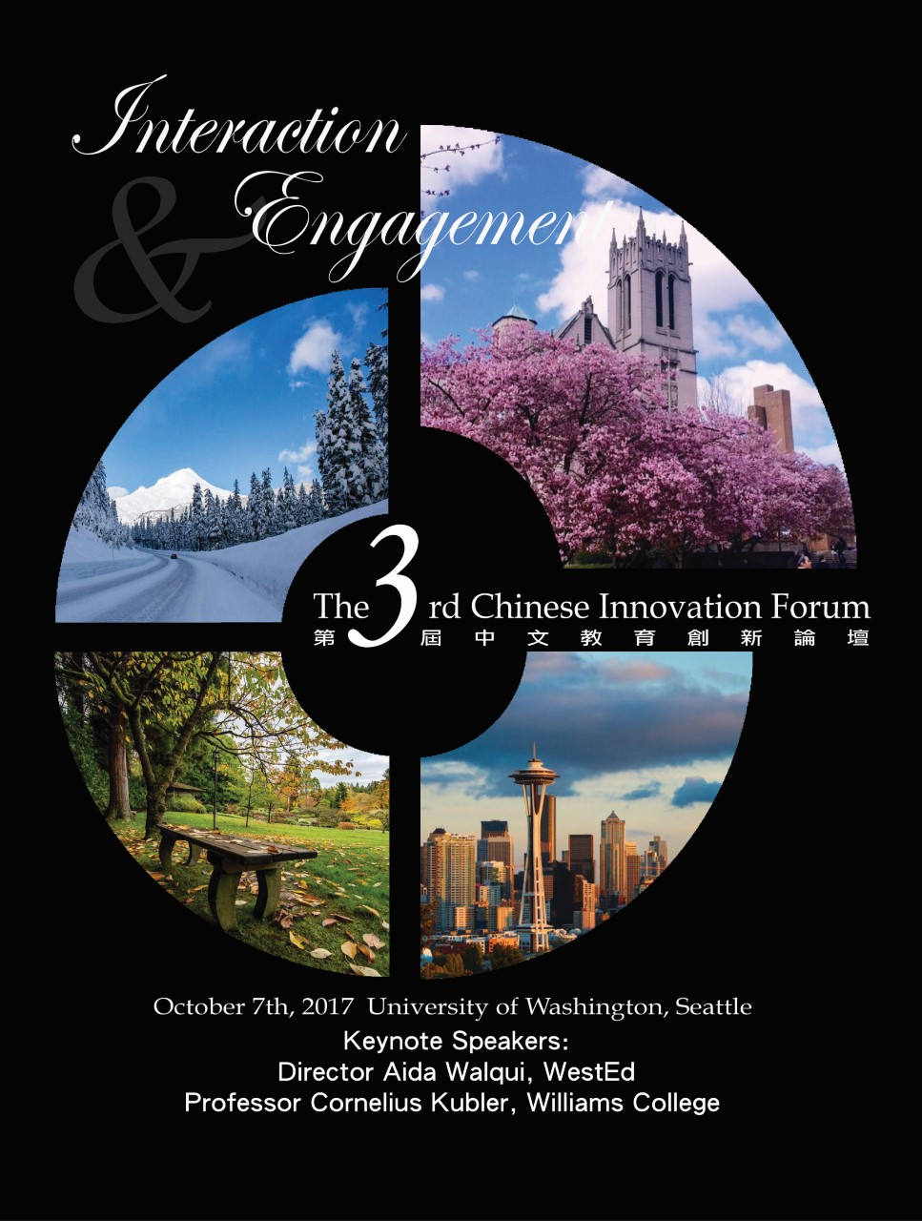
A Journey to Innovation

Slide 3
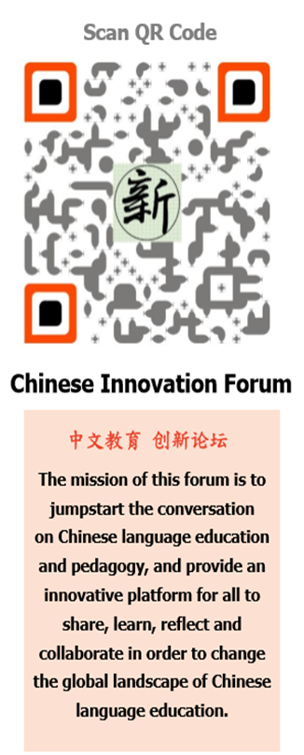
Mission of Chinese Innovation Forum
From: UBC Hua Dialogue

Slide 4
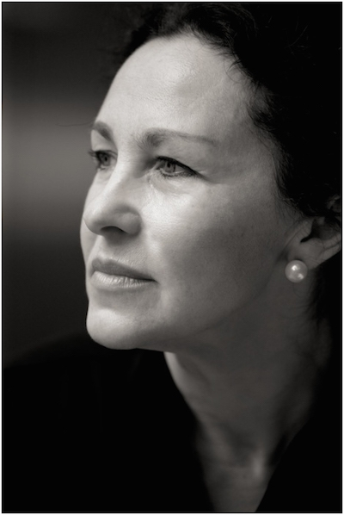
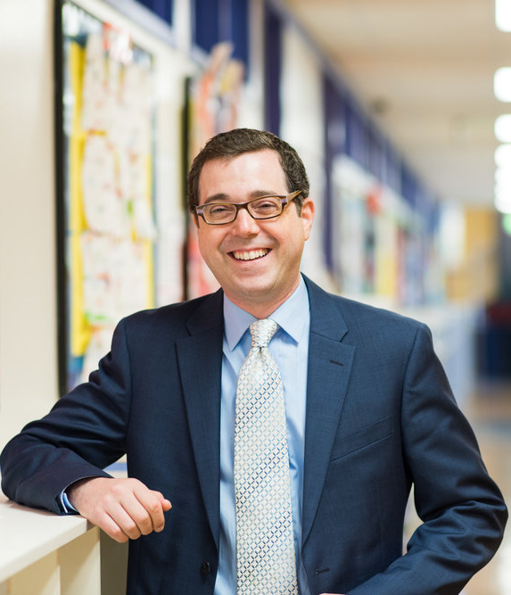
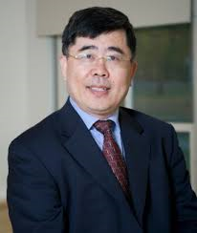
Format: Keynotes-Trade Fair-Reflection
Anna Vassilieva Chris Livaccari Jianhua Bai Jianhua Bai

Slide 5
Why Innovation Trade Fair?
Peter Shaw (2015 Keynote in Dai 2016 Innovative Pedagogy and Ecological Perspective)

Slide 6
Reflection moment
Experience Change
Innovation Journey continues…
Appreciate
I
© Jinhuei Enya Dai
Becoming an agent
Showing gratitude

Slide 7
Fundraising Strategies
Fundraising goal: What you are raising the money for?
How much to raise? How to raise? From whom to raise?
What else can be achieved while raising money?

Slide 8
What you are raising the money for? To host innovation forum
To bring innovation in the field
To impact and to influence Teaching Chinese as a Foreign Language
This forum highlights: Tangible practices Innovations from bottom-up (classrooms) Grassroots ideas
Instill the idea that each one of our teachers can make a difference in the field-Bold Leadership
Build the community’s awareness of the good works by frontline teachers, supported by the theories of leading scholars

Slide 9
How much to raise?
 | items | cost
1 | Keynote speaker’s honorarium | $700 X 2 = $1,400
2 | Keynote speaker’s hotel | $240 X 2 X 2 = $960
3 | Keynote speaker’s travel | $1,700
4 | Classroom rental | $1,000
5 | lunch | $1,500
6 | printing posters, pamphlets | $500
7 | travel compensation for presenters | $200 X 10 = $2,000
total |  | $9,060

Slide 10
How to fundraise?
-Make the forum attractive
Invite distinguished scholars from in and outside of our field
Invite frontline teachers to participate in trade fairs, to share their classroom ideas with colleagues
Open classrooms to visitors to increase visibility
Promote direct in-person communication among scholars
Choose a highly desirable place to host the forum

Slide 11
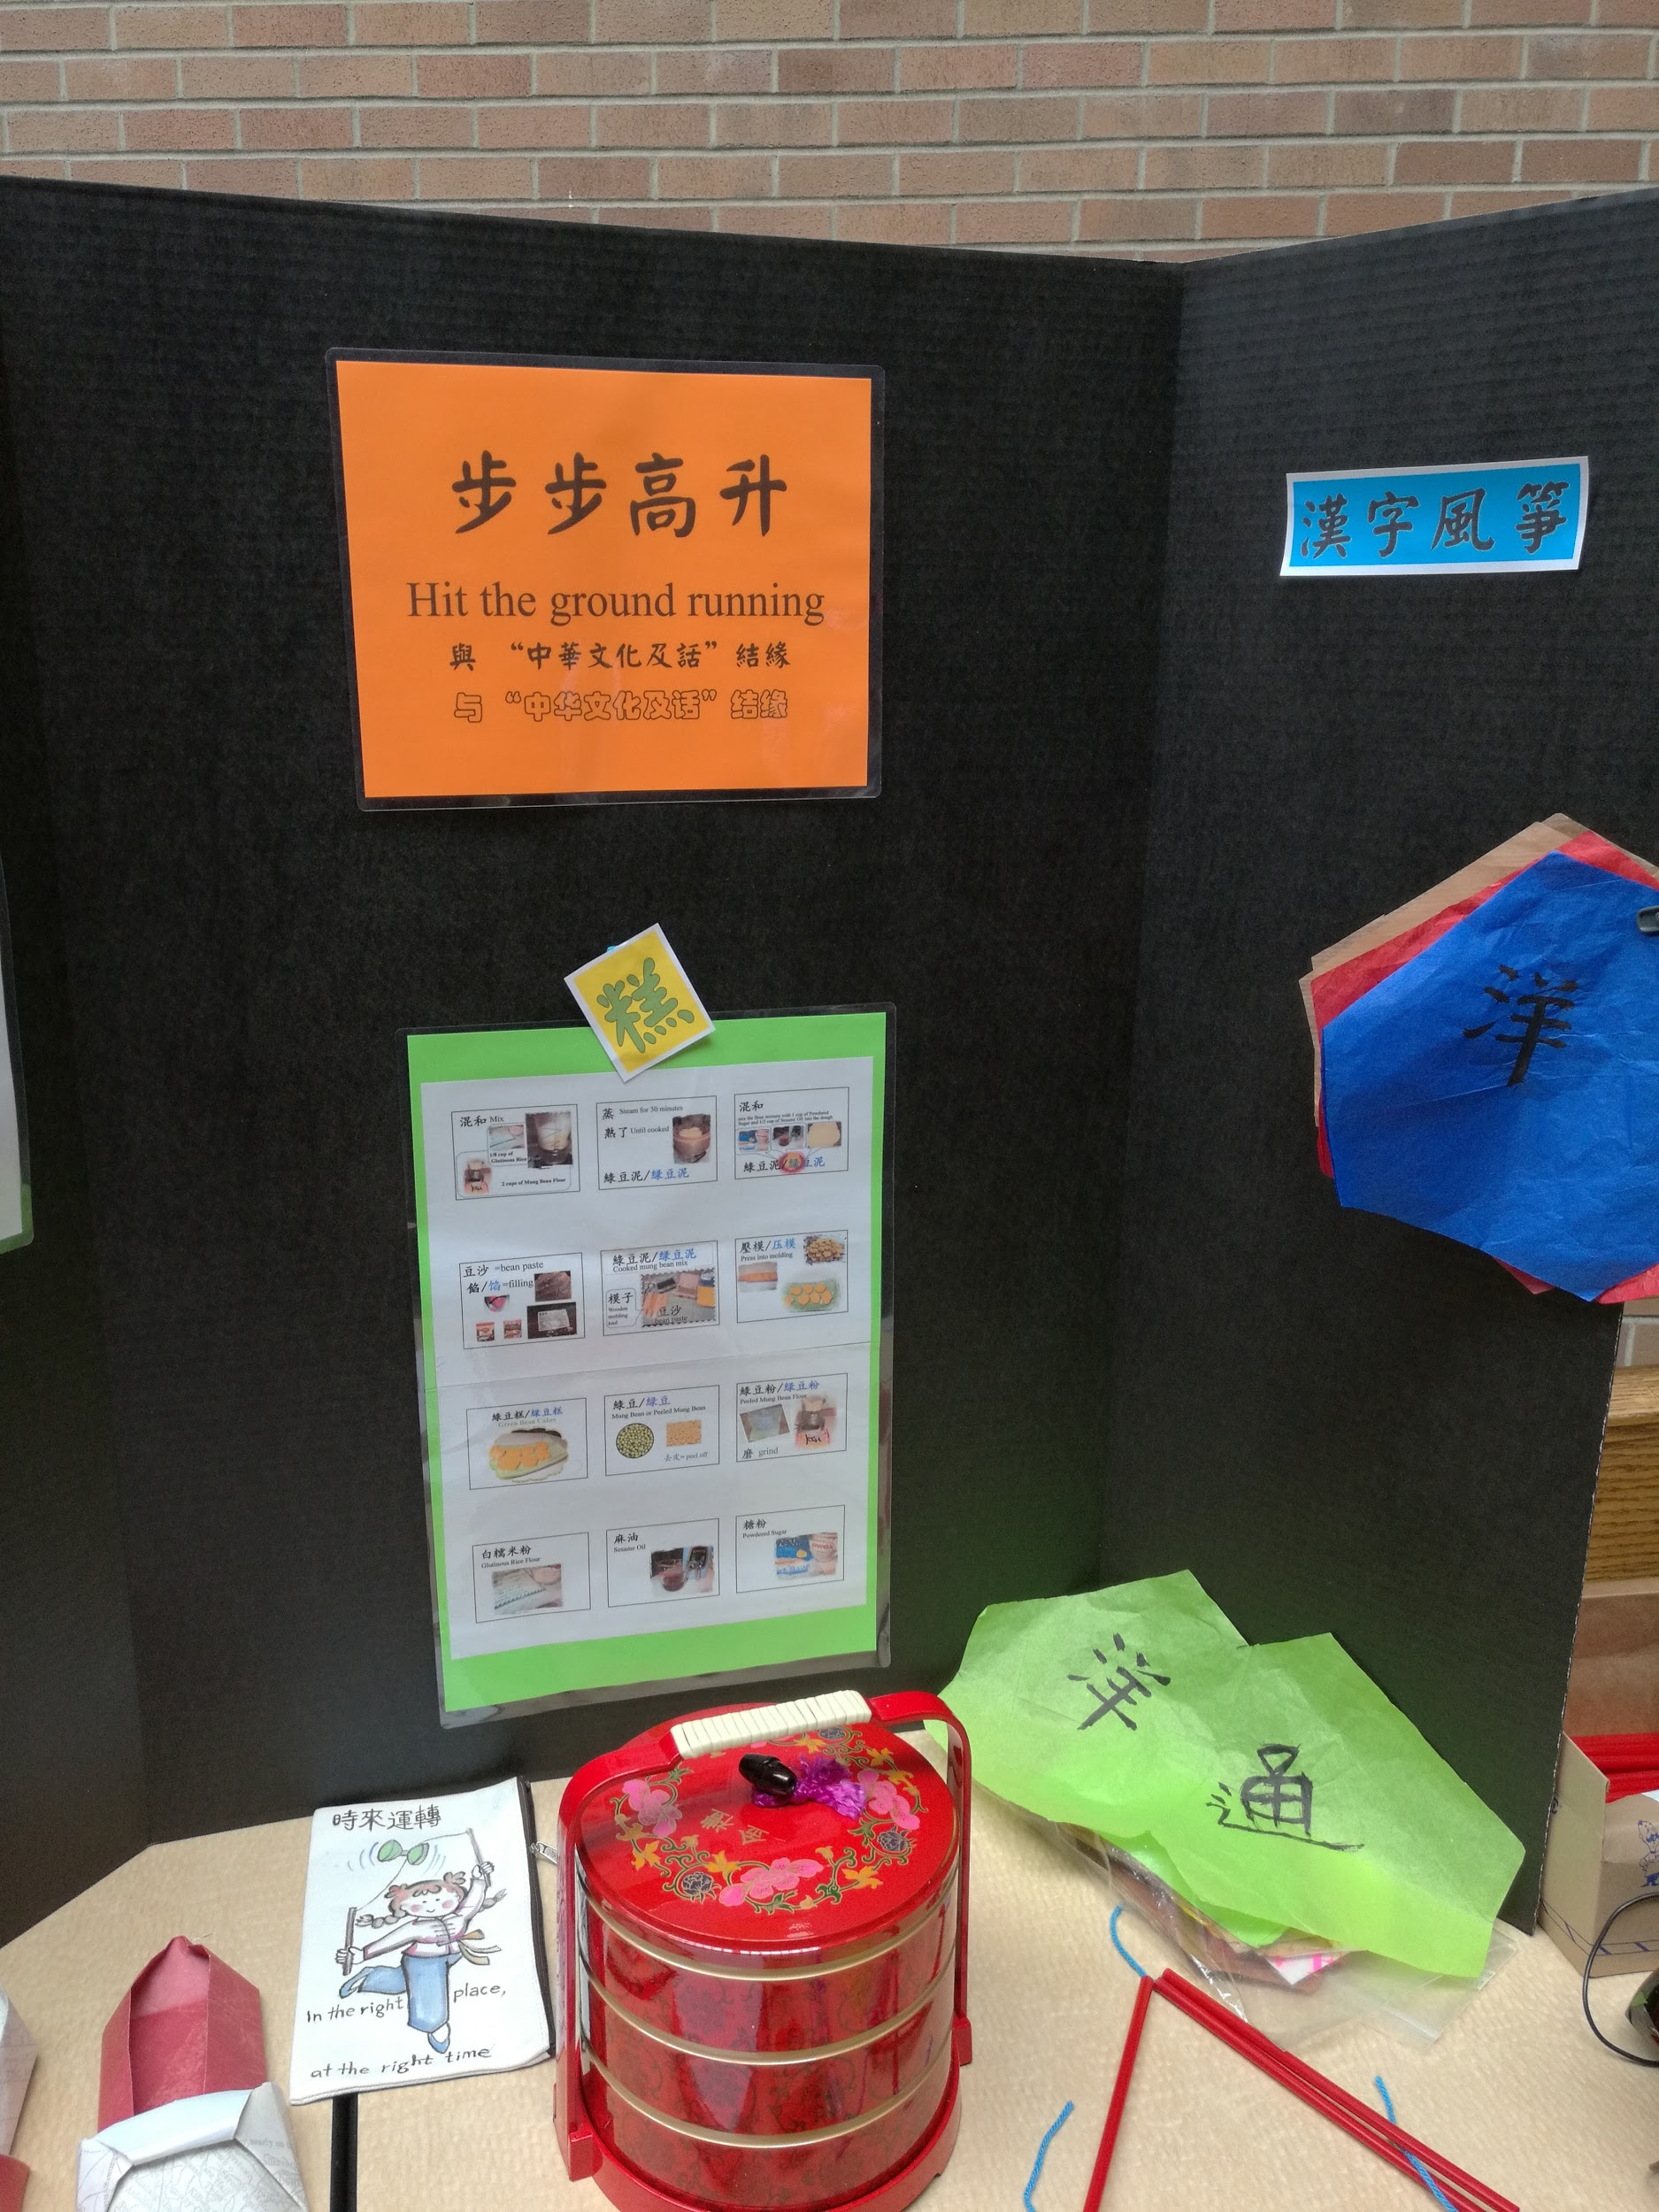
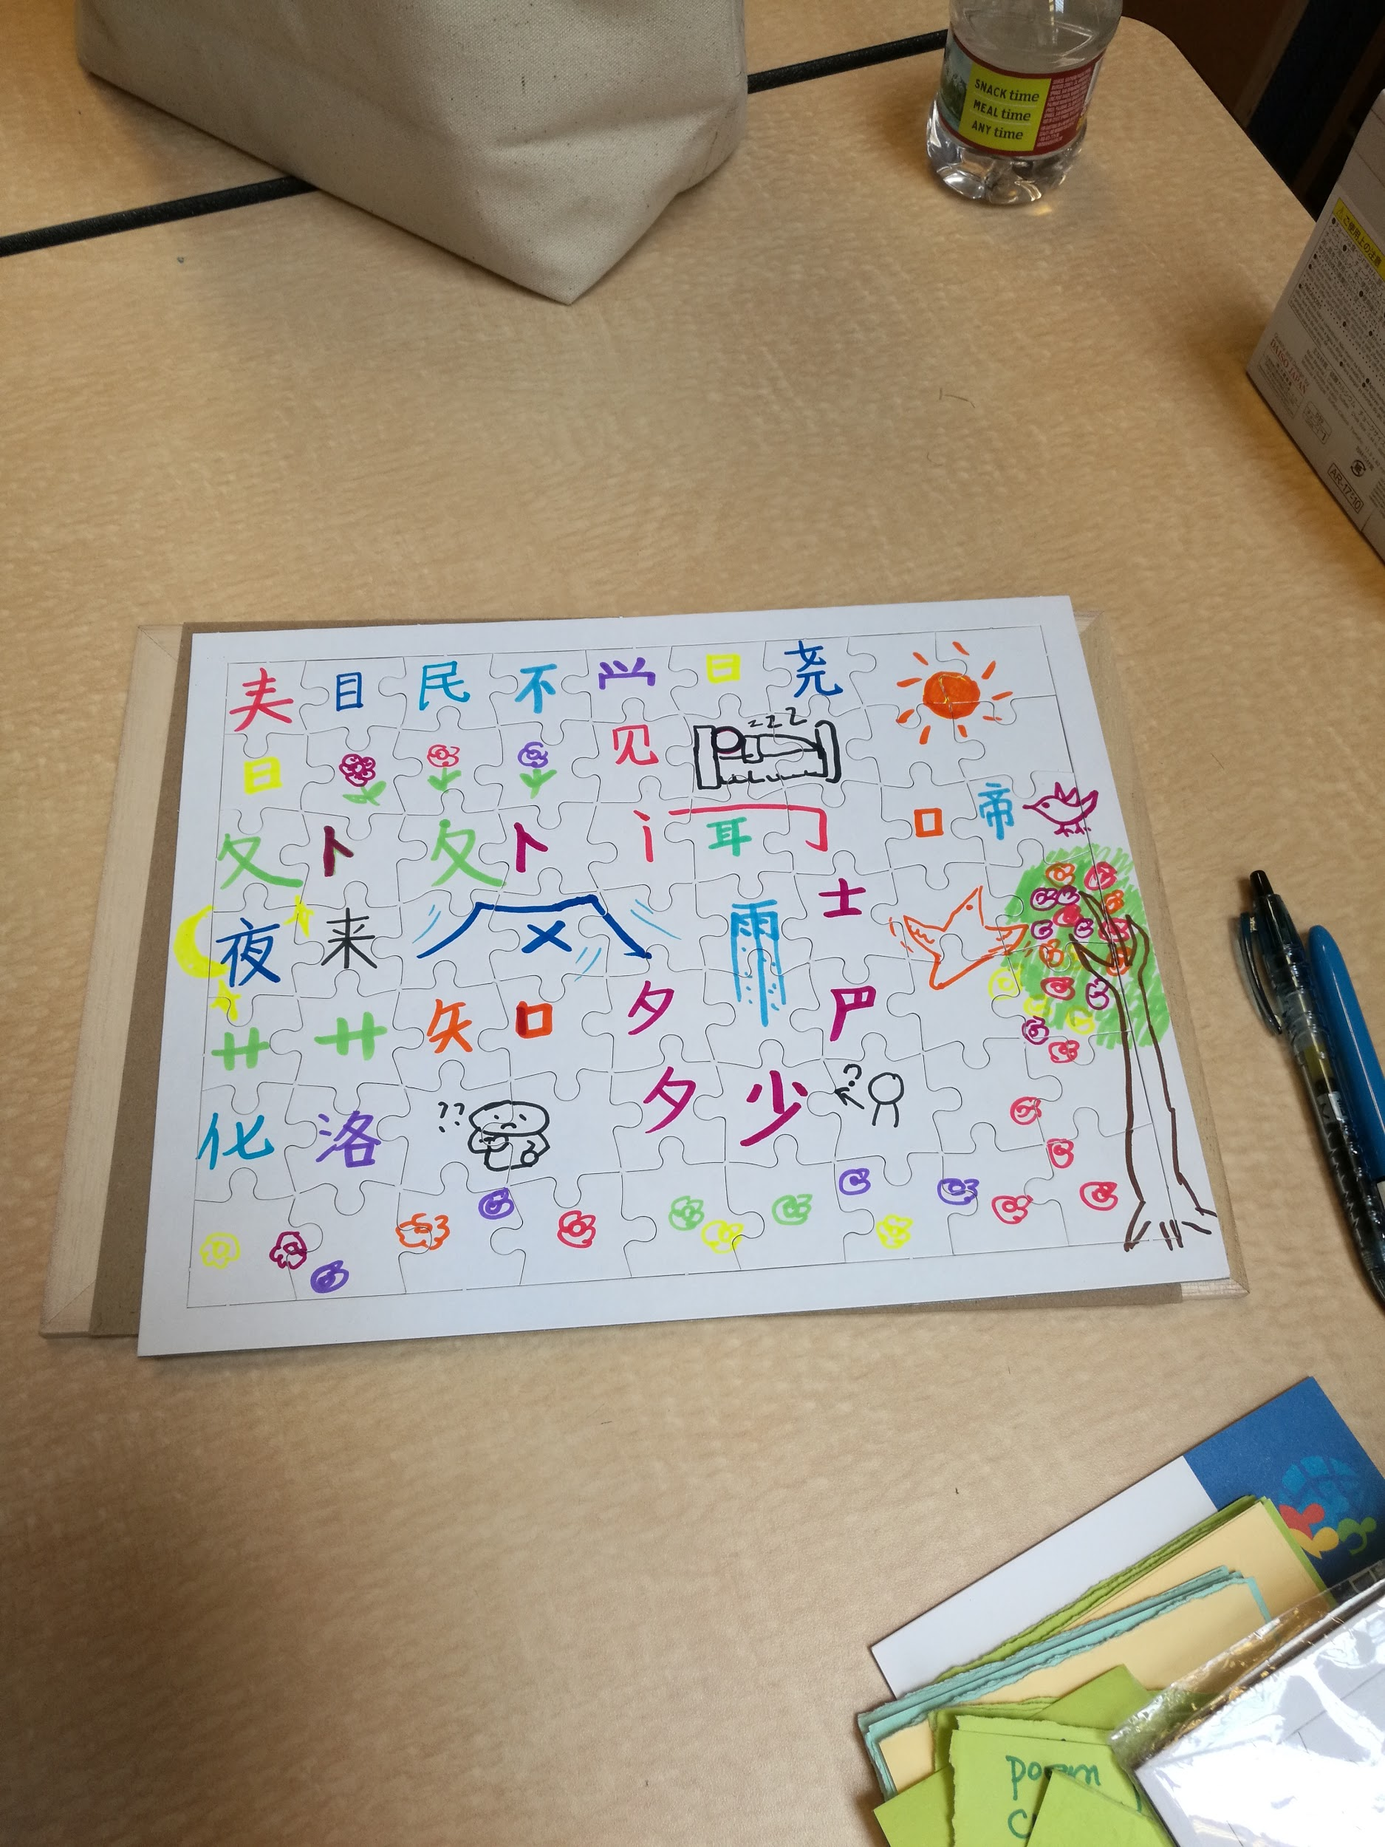
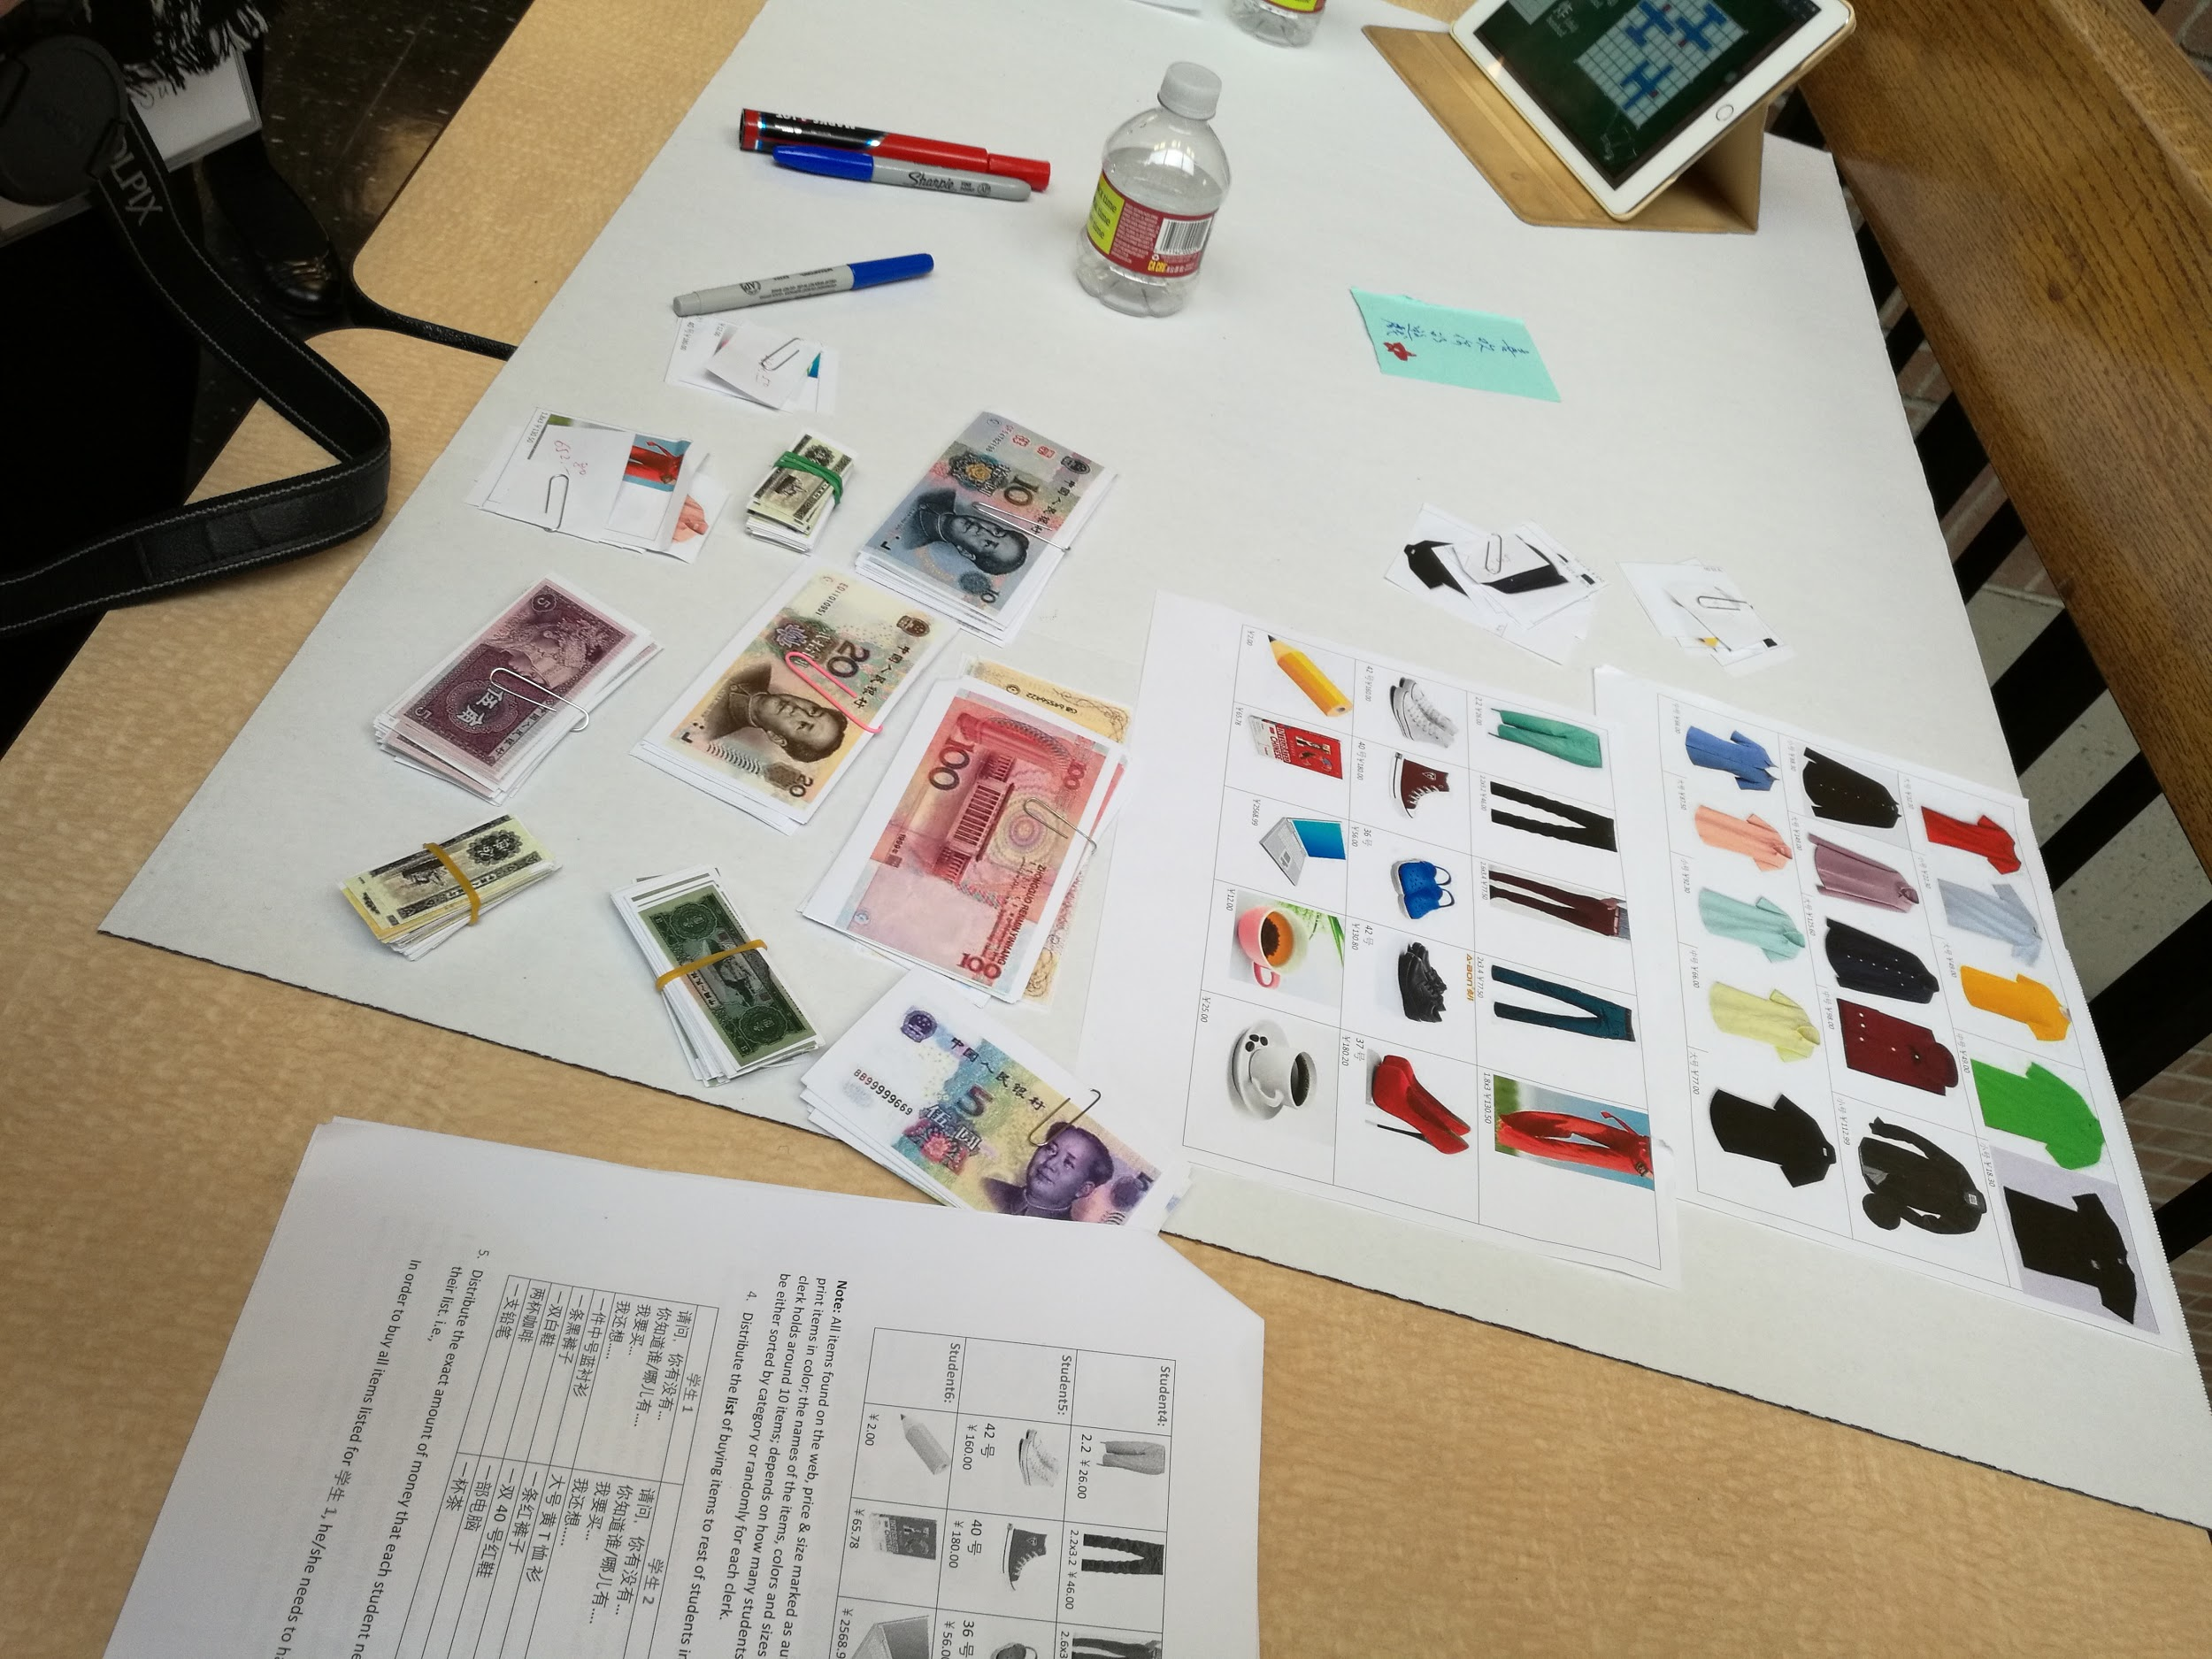
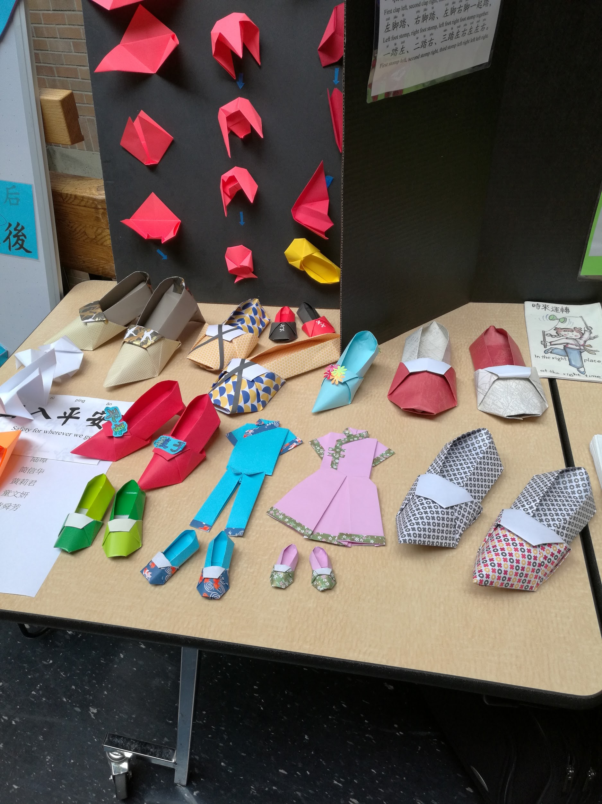
How to fundraise?
-Make the forum attractive

Slide 12
Identify leading scholars as keynote speakers
Through research and networking, identify leading scholars
Communicate to potential speakers, let them know our intention & vision, invite them to come and share their expertise
Share the Forum’s limited budget and try to convince the speakers to support us

Slide 13
Identify excellent teachers and invite them to come
Through professional and personal networking
In addition to sending out announcements through profession channels, make personal call or email to invite teachers to come
Print forum postcards specially designed for the conference and send out hand-written invitations to as well

Slide 14
Sharing the Program of the Forum
Outline Forum details
Put the program online, and send the link to all the possible participants, and update the information periodically
Send reminders to participants
Try to accommodate participants to increase attendance

Slide 15
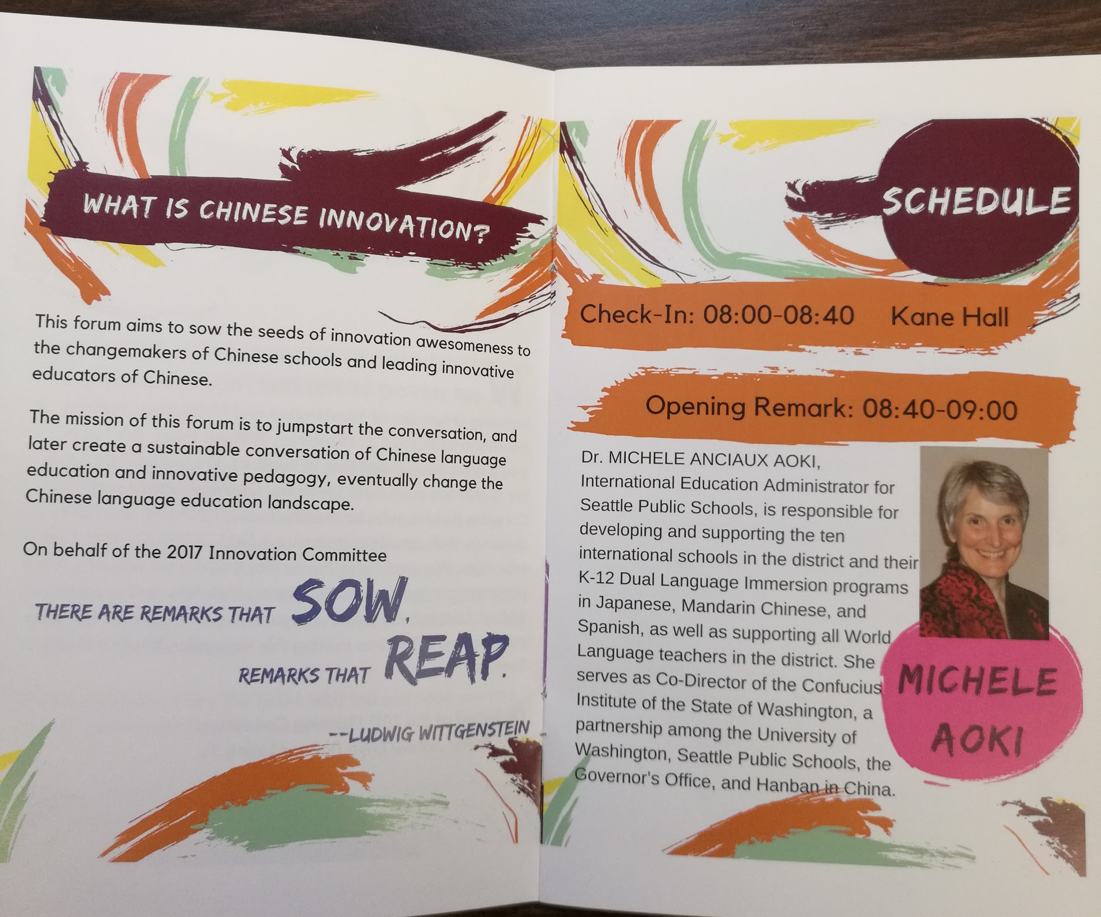
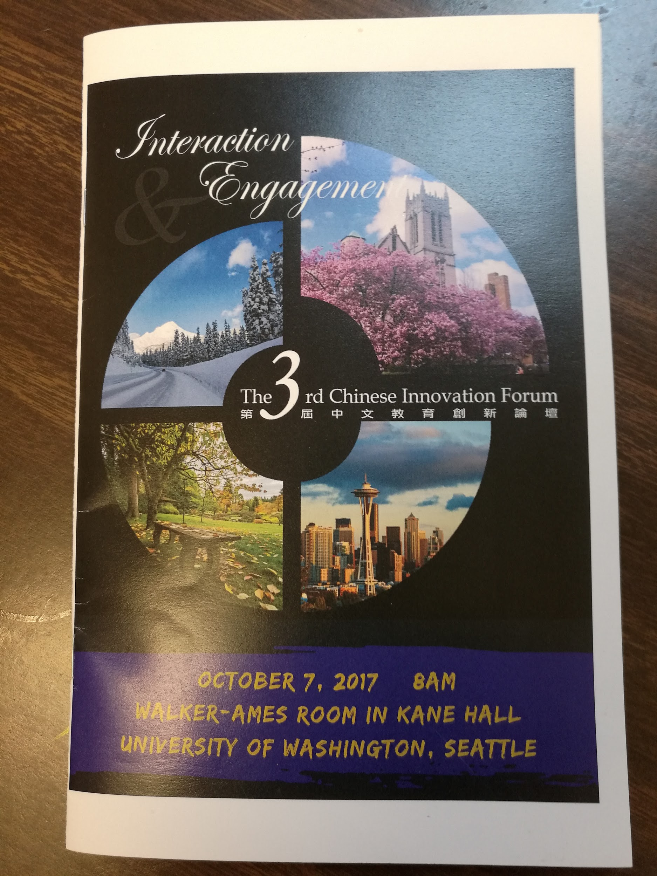
The 3rd Innovation Forum -Program

Slide 16
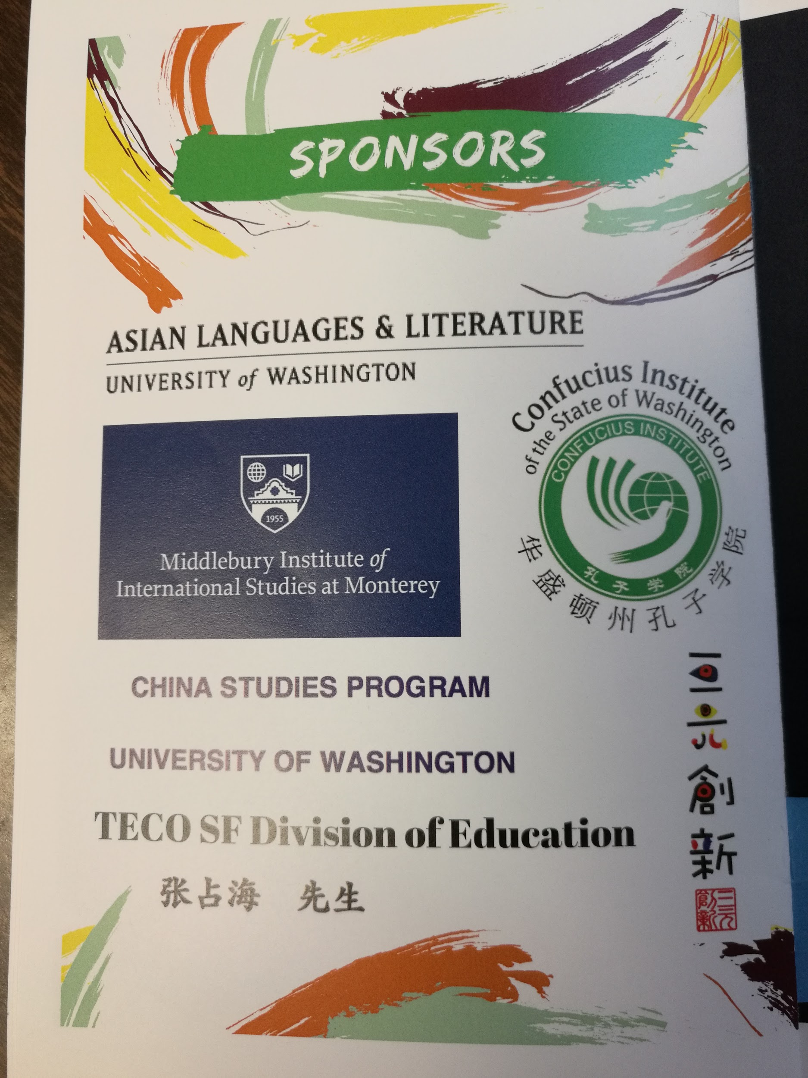
How to fundraise?---Write and talk to potential donors
East Asian Center
China Studies
Confucius Center
Hosting Dept. Chair
Education Council of the Embassy
Individual donors
webdesigner and photographer

Slide 17
How to fundraise? ---Get donors involved
Invite the donors to attend the Forum
Educate the donors about what we do, how we spend funds
Get them involved throughout the planning process and establish relationships
Personally thank the donors if possible; write thank-you cards to the donors

Slide 18
What else can be achieved while fundraising?
Network to build relationships and future collaboration
Be inspired by the works of other teachers and improve our own teaching
Attract large numbers of volunteers, and other active supporters
Recognize accomplishments of frontline teachers

Slide 19
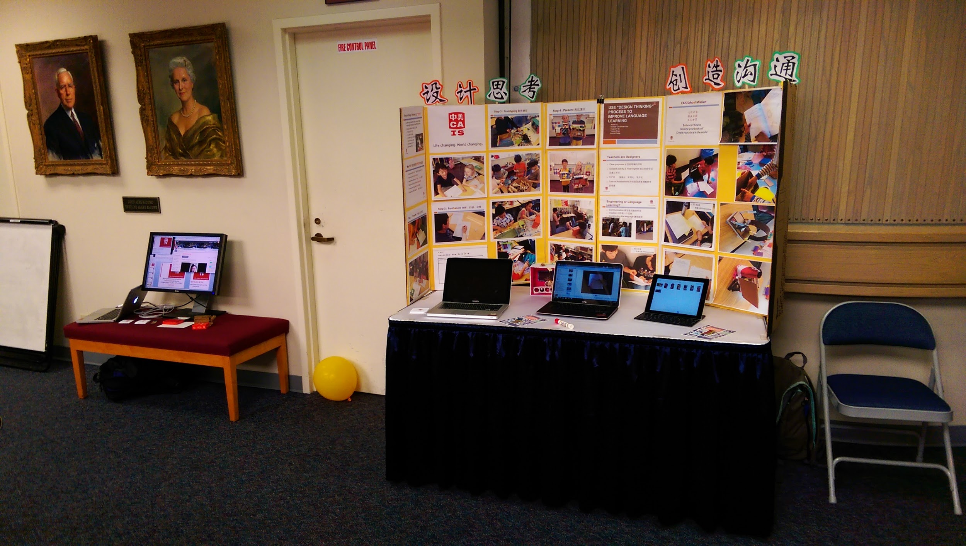
Impact of Innovation Forum
and
Leadership Development

Slide 20
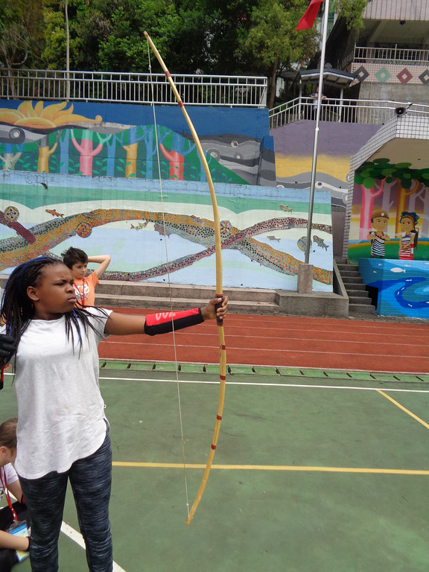
Our Takeaways as Participants
As a result of the forum, We...
Think broader and deeper about the curriculum
Work on strategies for creativity and engaging the students
Foster Leadership Development

Slide 21
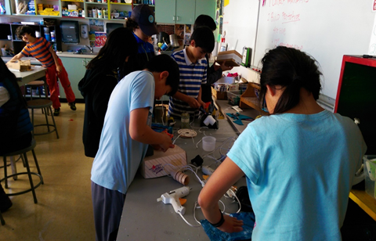
From the Curricular Aspect
How do we make our curriculum have more
Relevance to students
Connection with other subjects, so Chinese is not an isolated subject
Hands-on learning
Deep learning through the language
How do we motivate students?

Slide 22
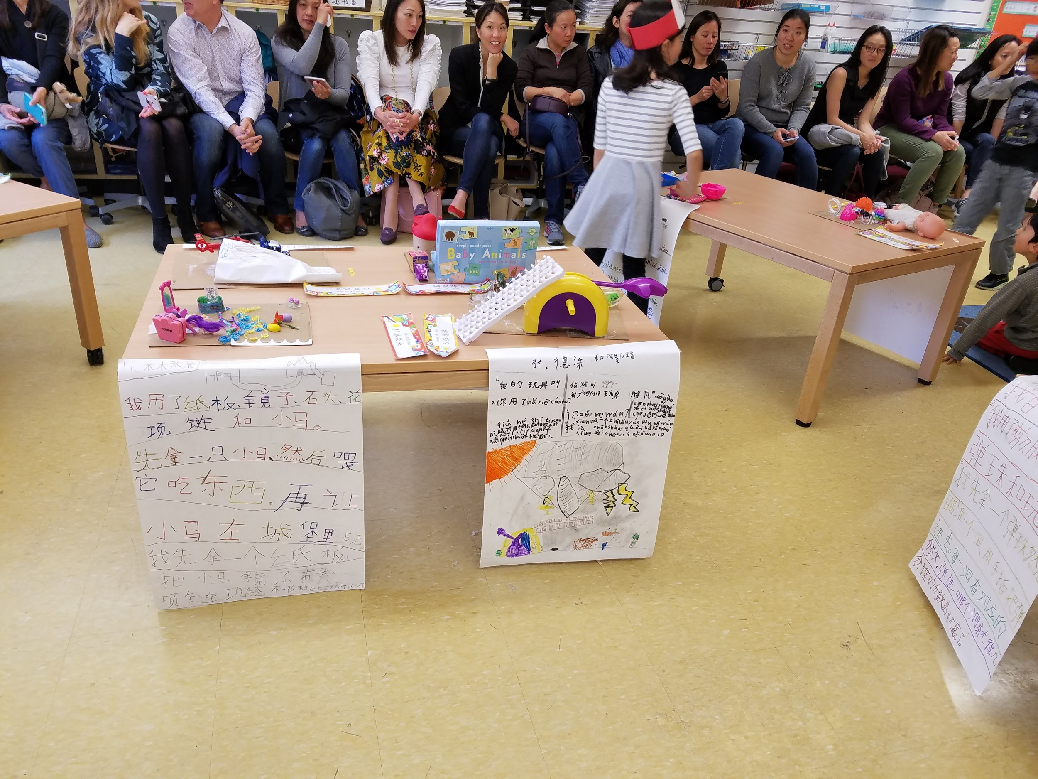
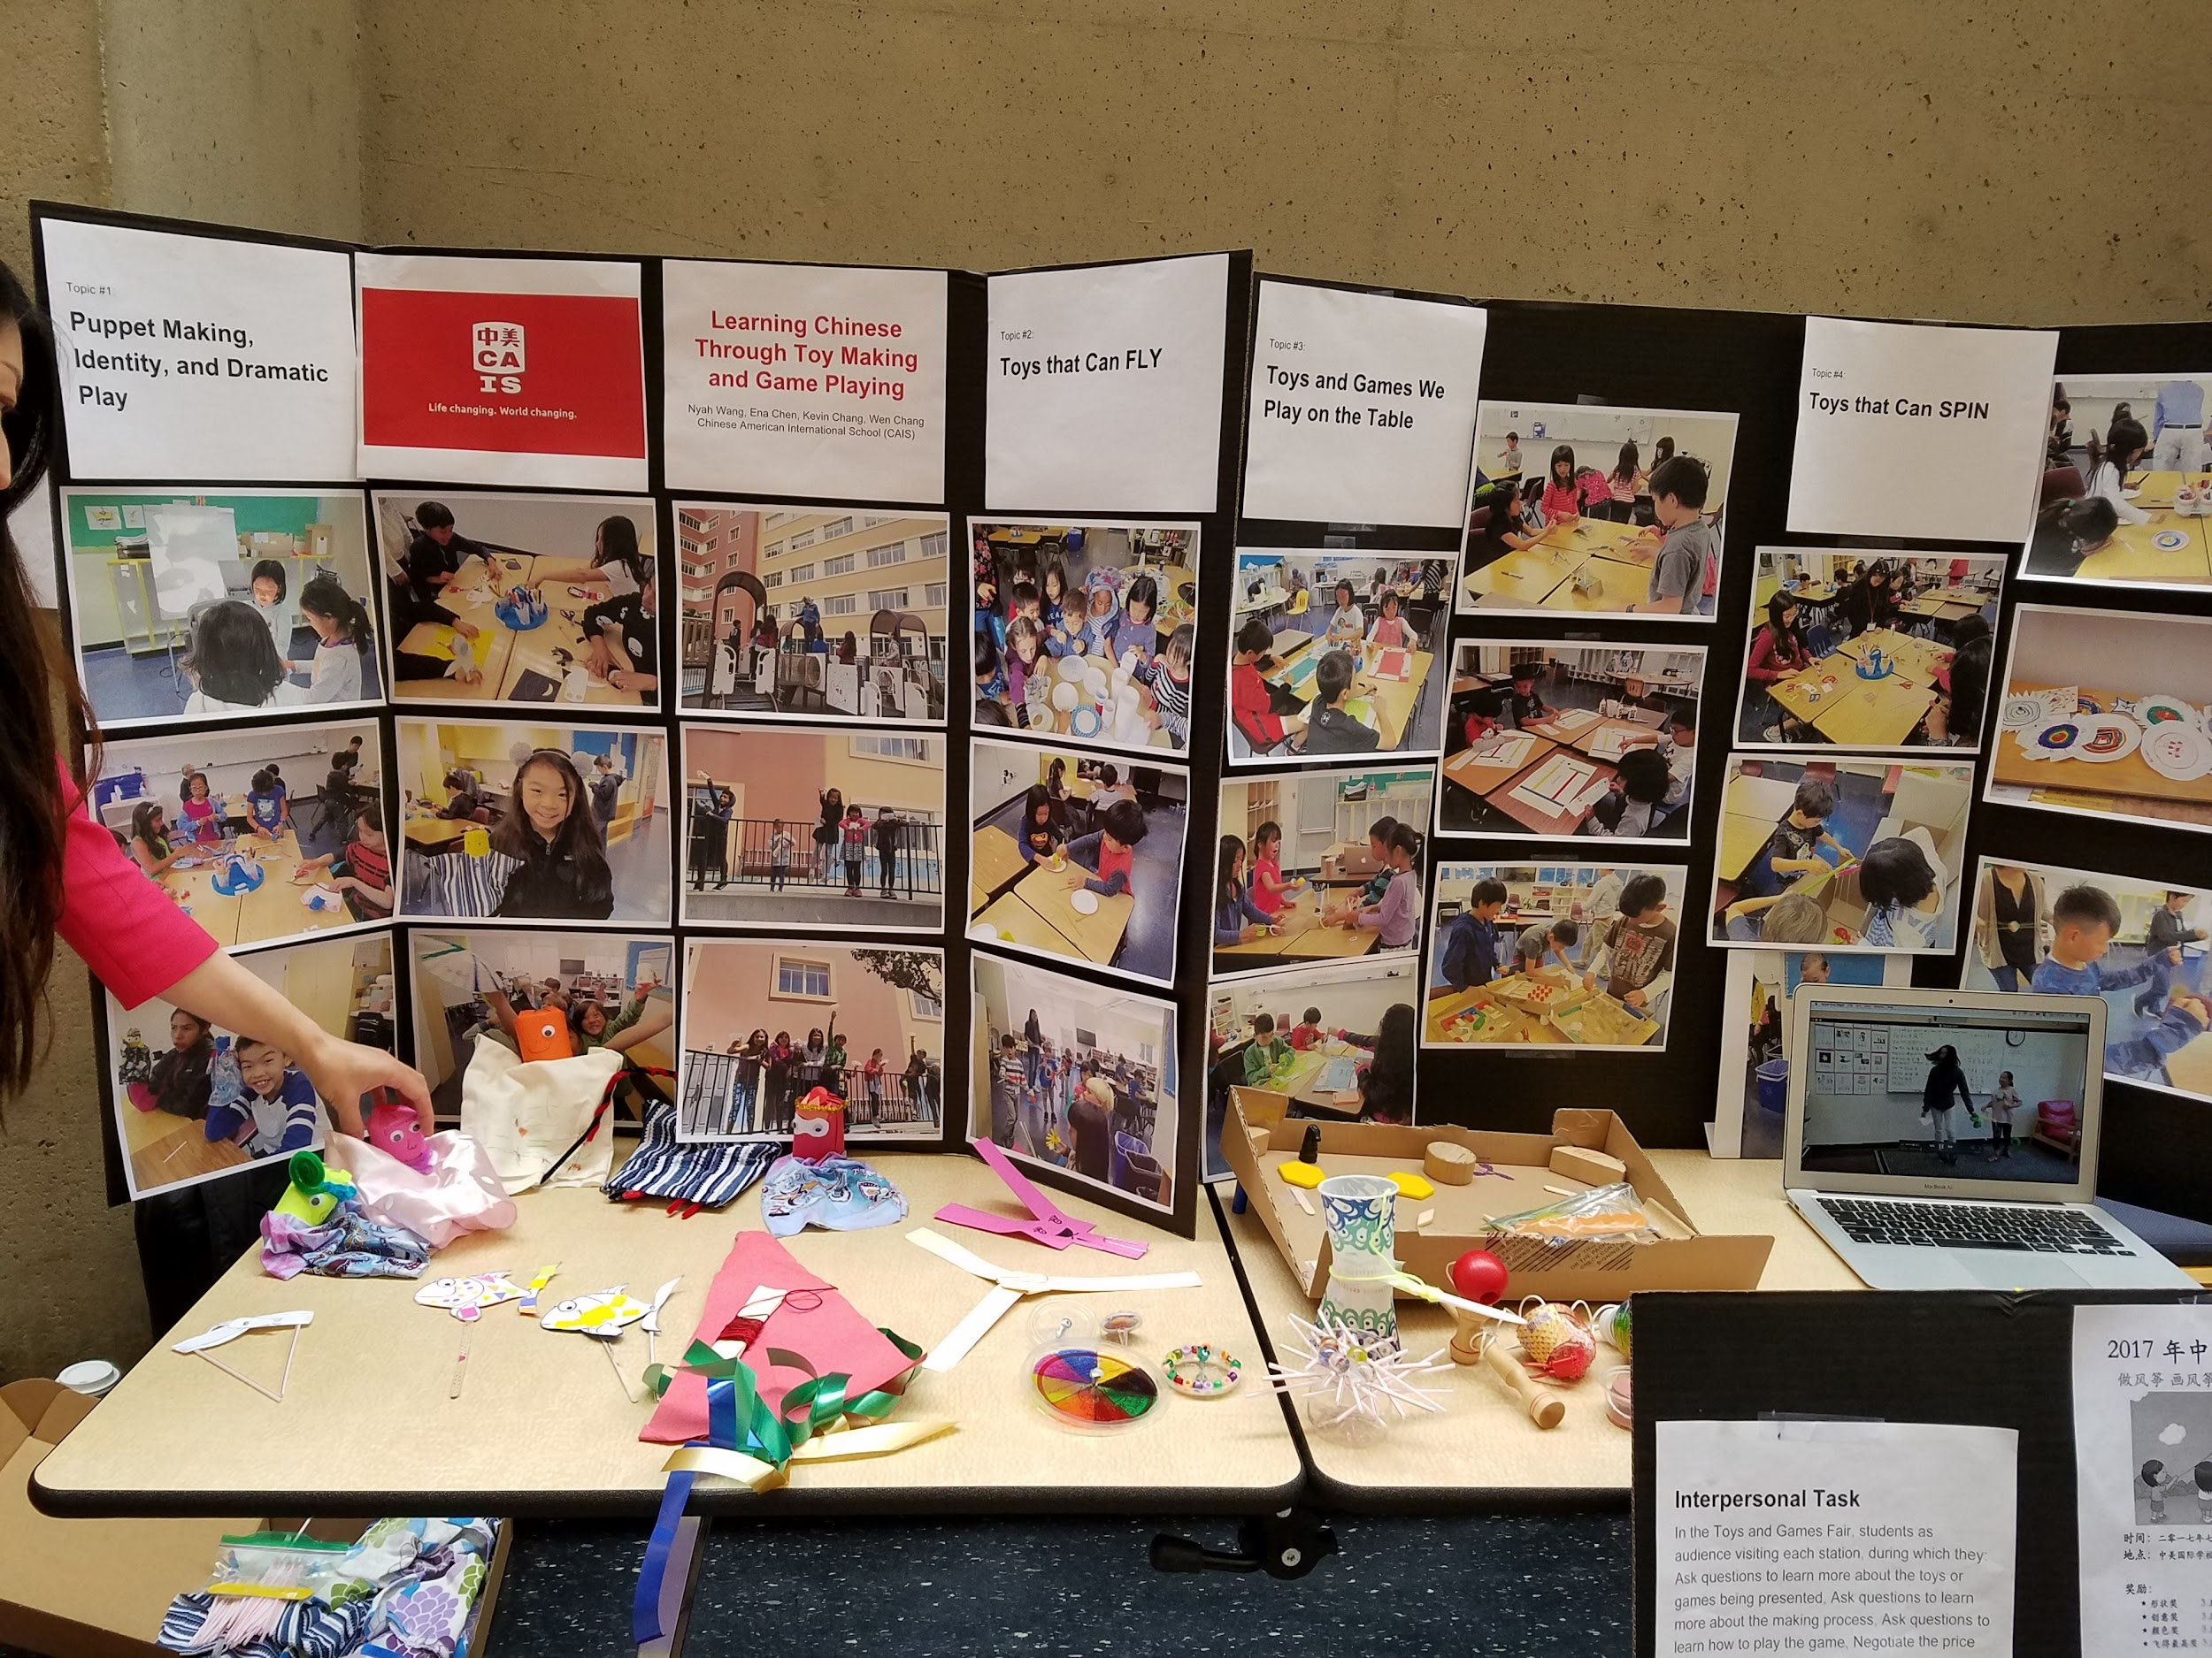
2. Work on strategies for Creativity and Engaging the Students
Topics that foster high interest

Slide 23
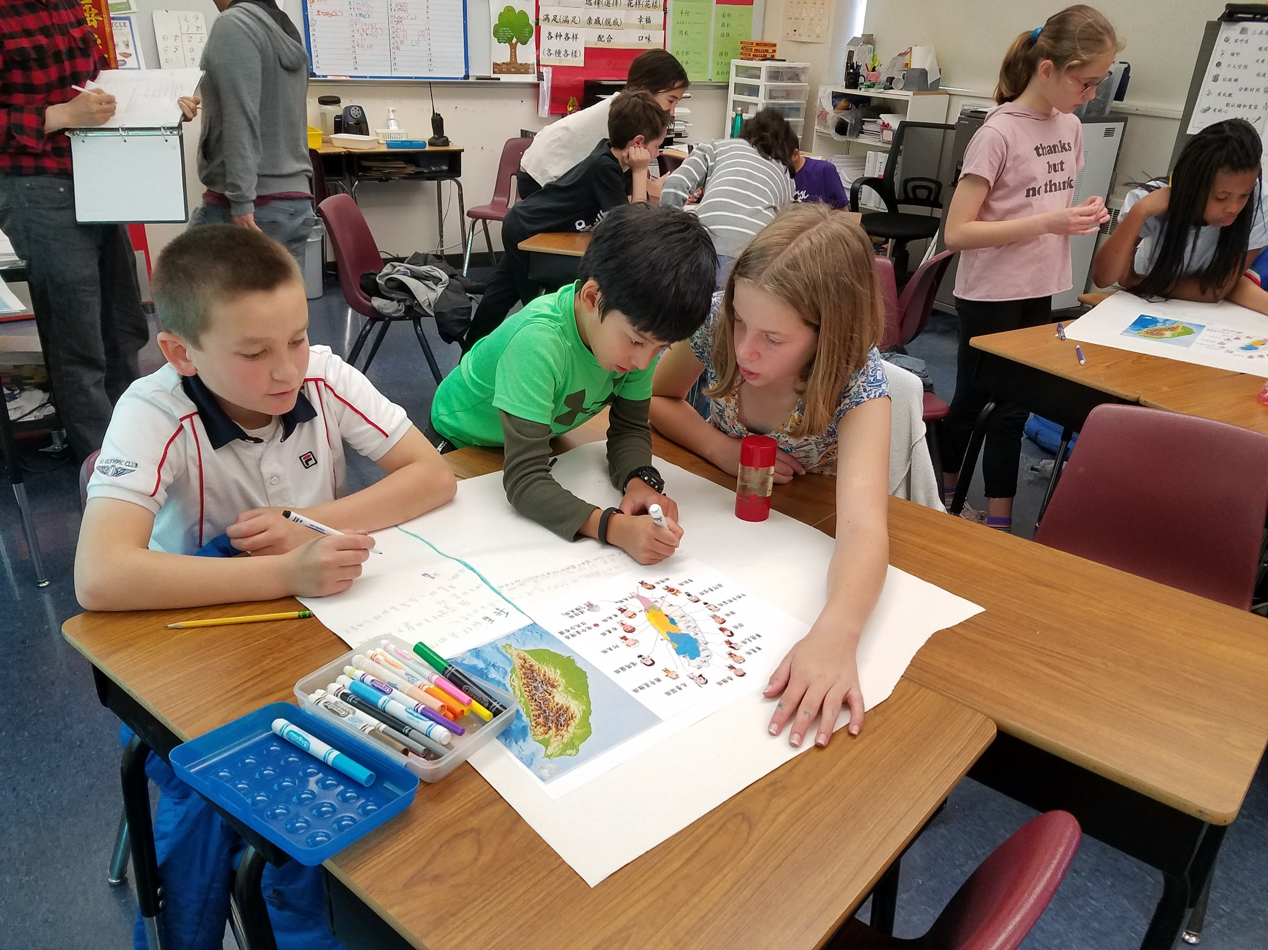
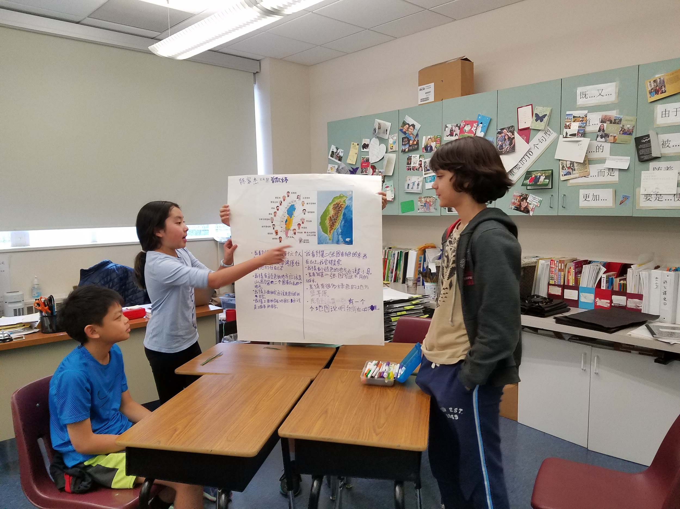
2. Work on strategies for Creativity and Engaging the Students
Focus on bigger issues of the world
Collaboration
Observation-Interpretation-Opinion

Slide 24
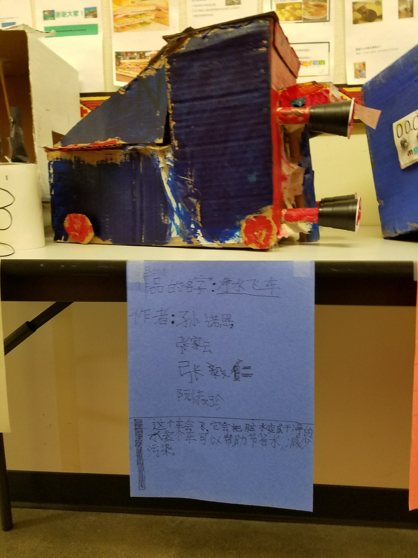
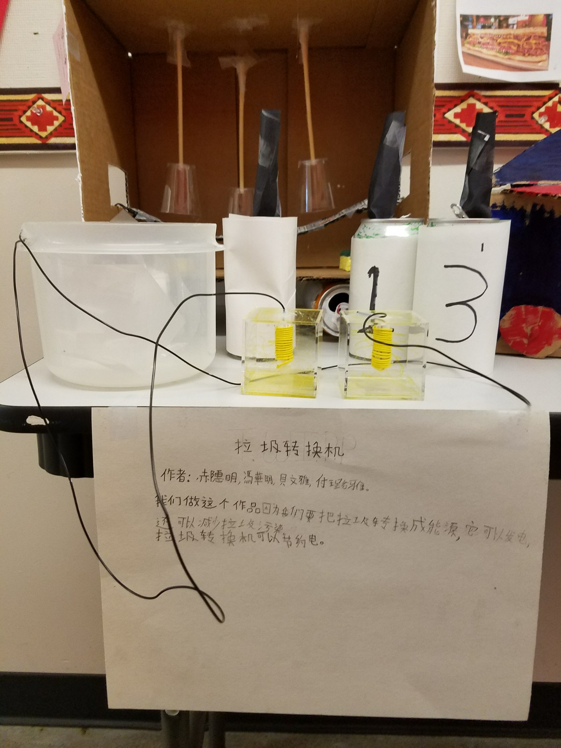
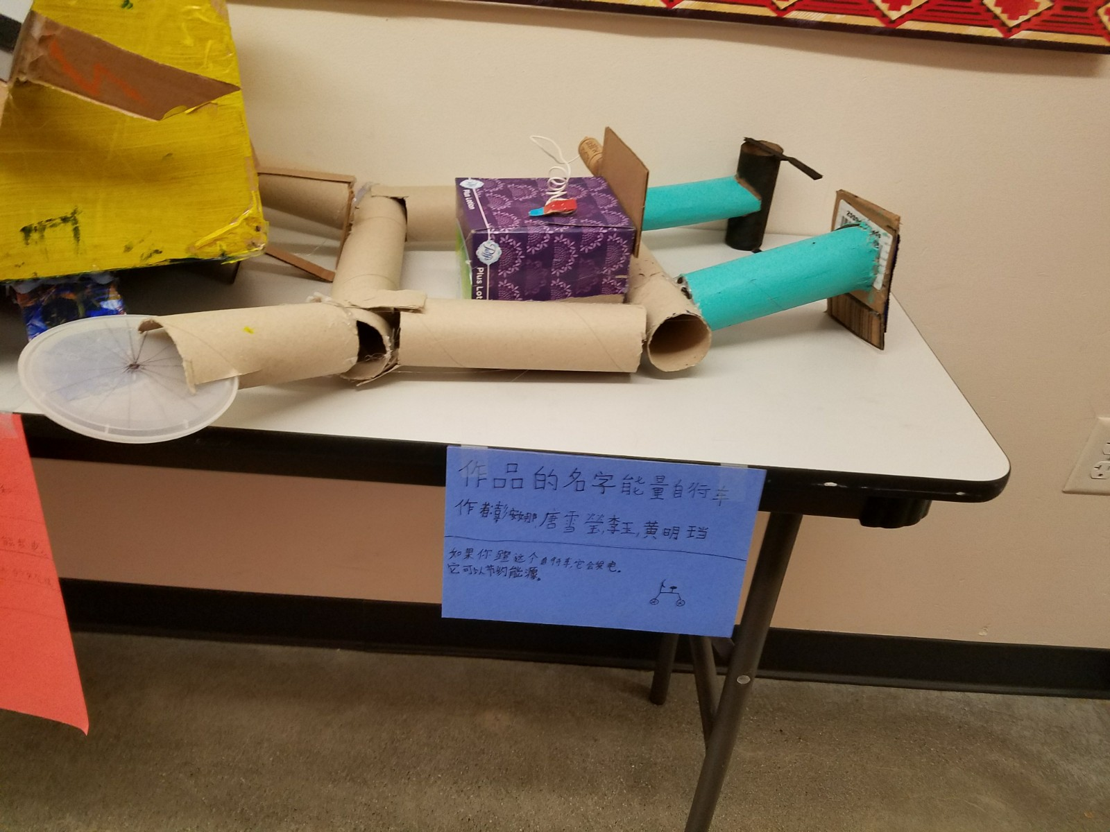
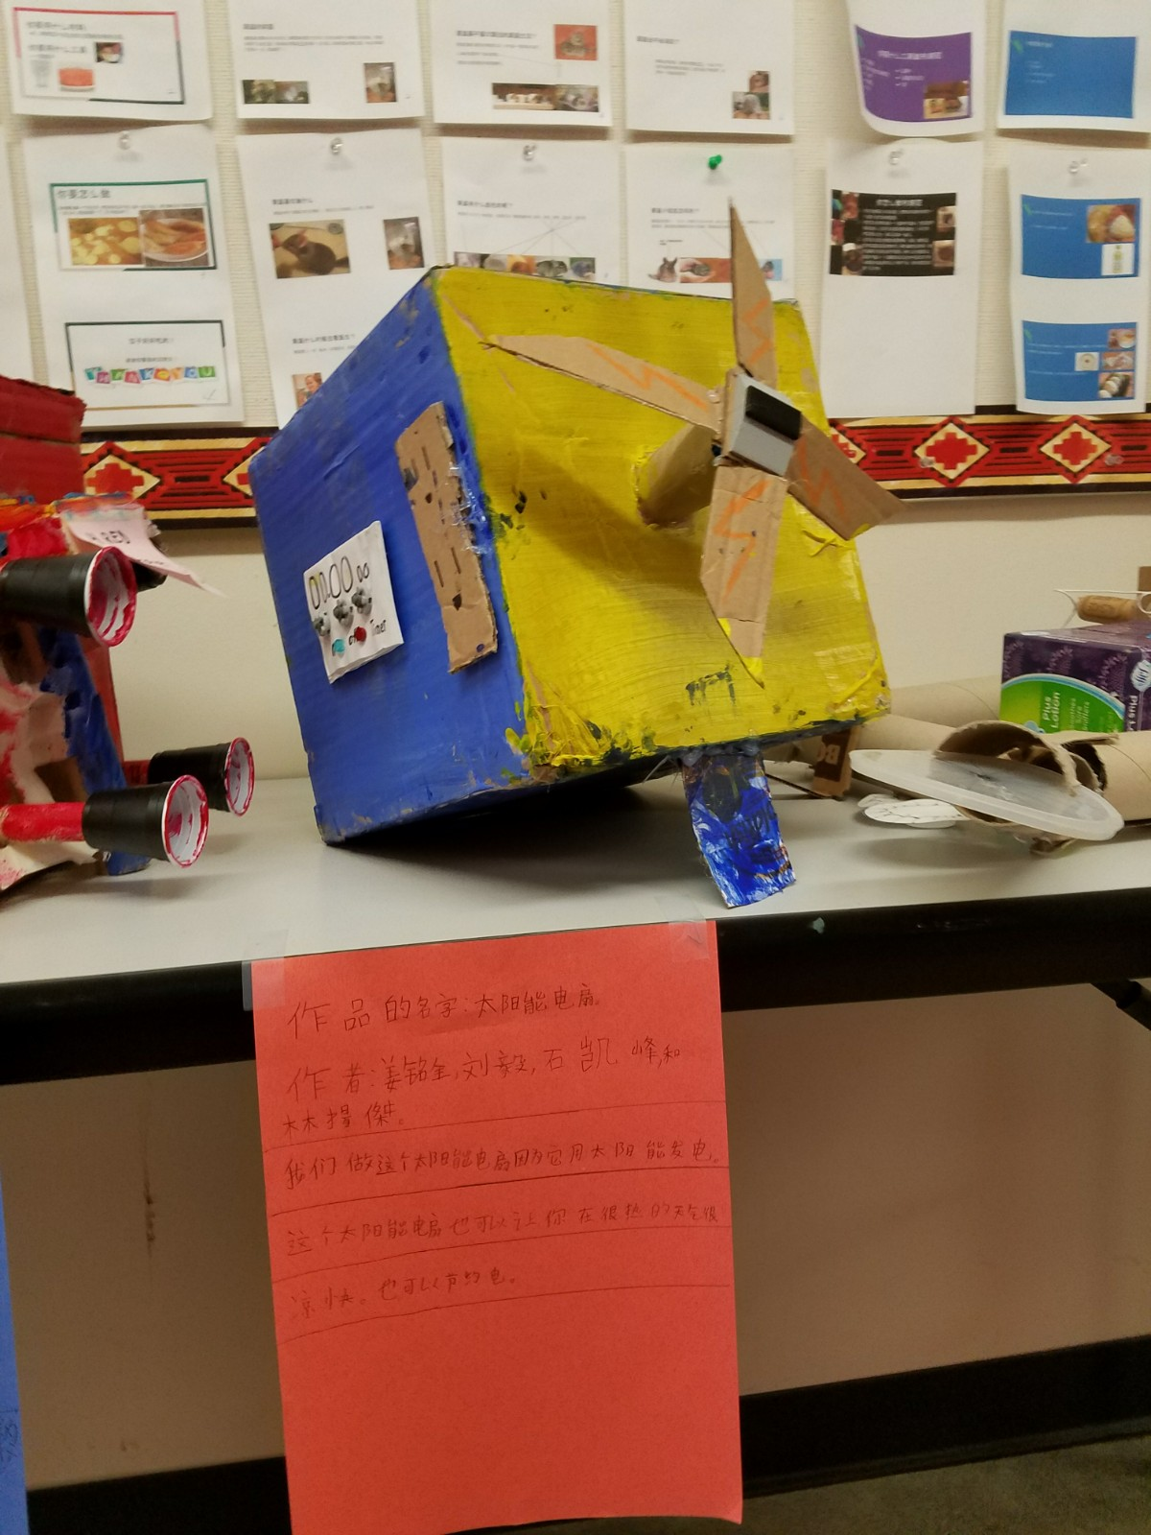
G4: Saving Energy

Slide 25
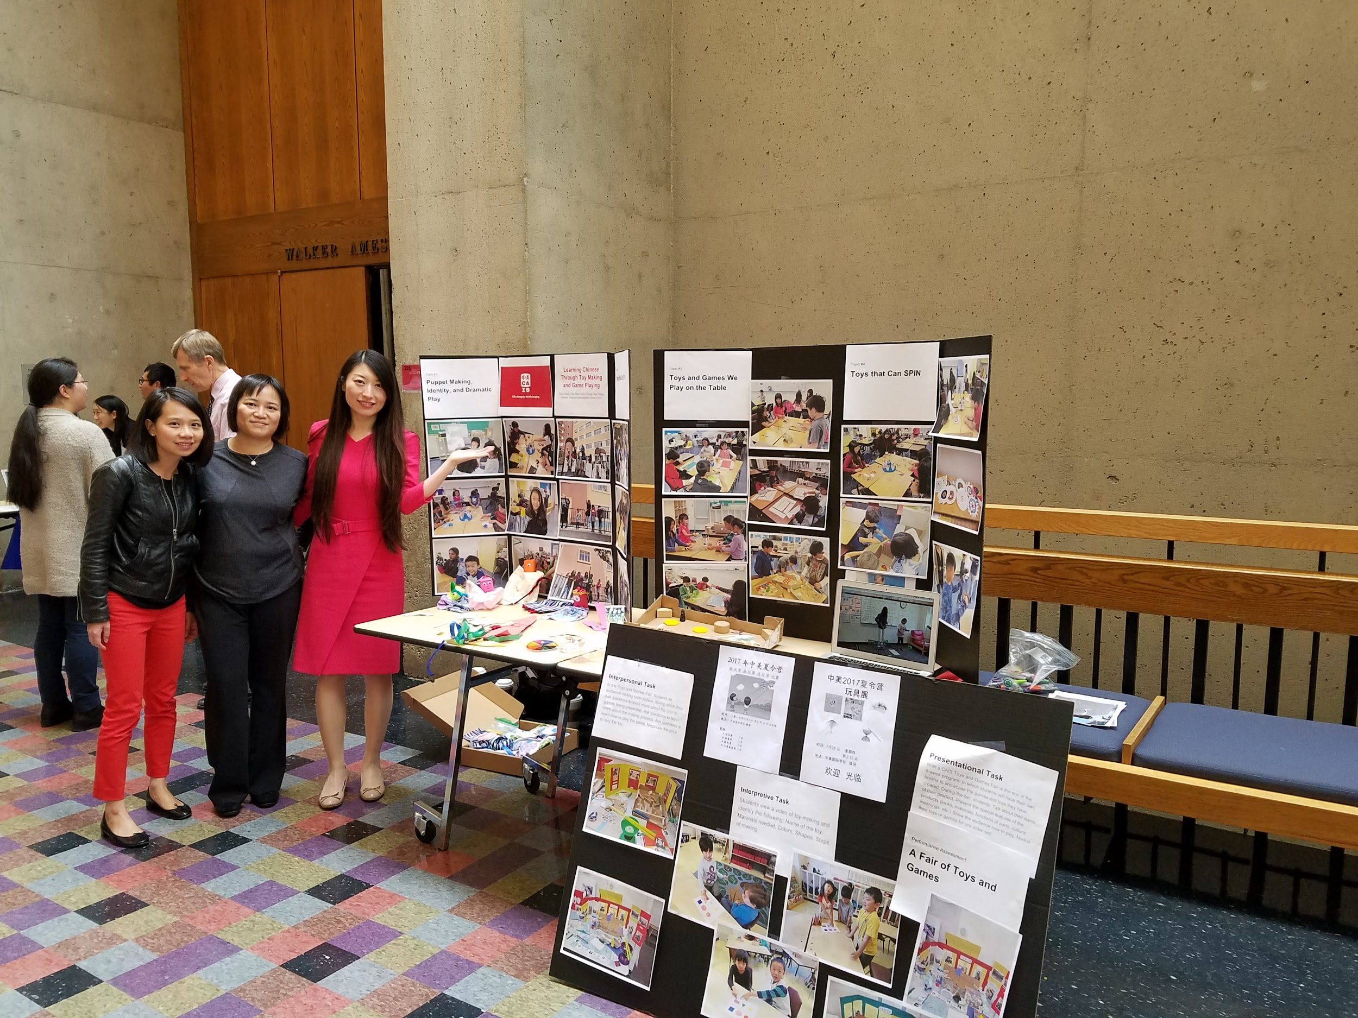
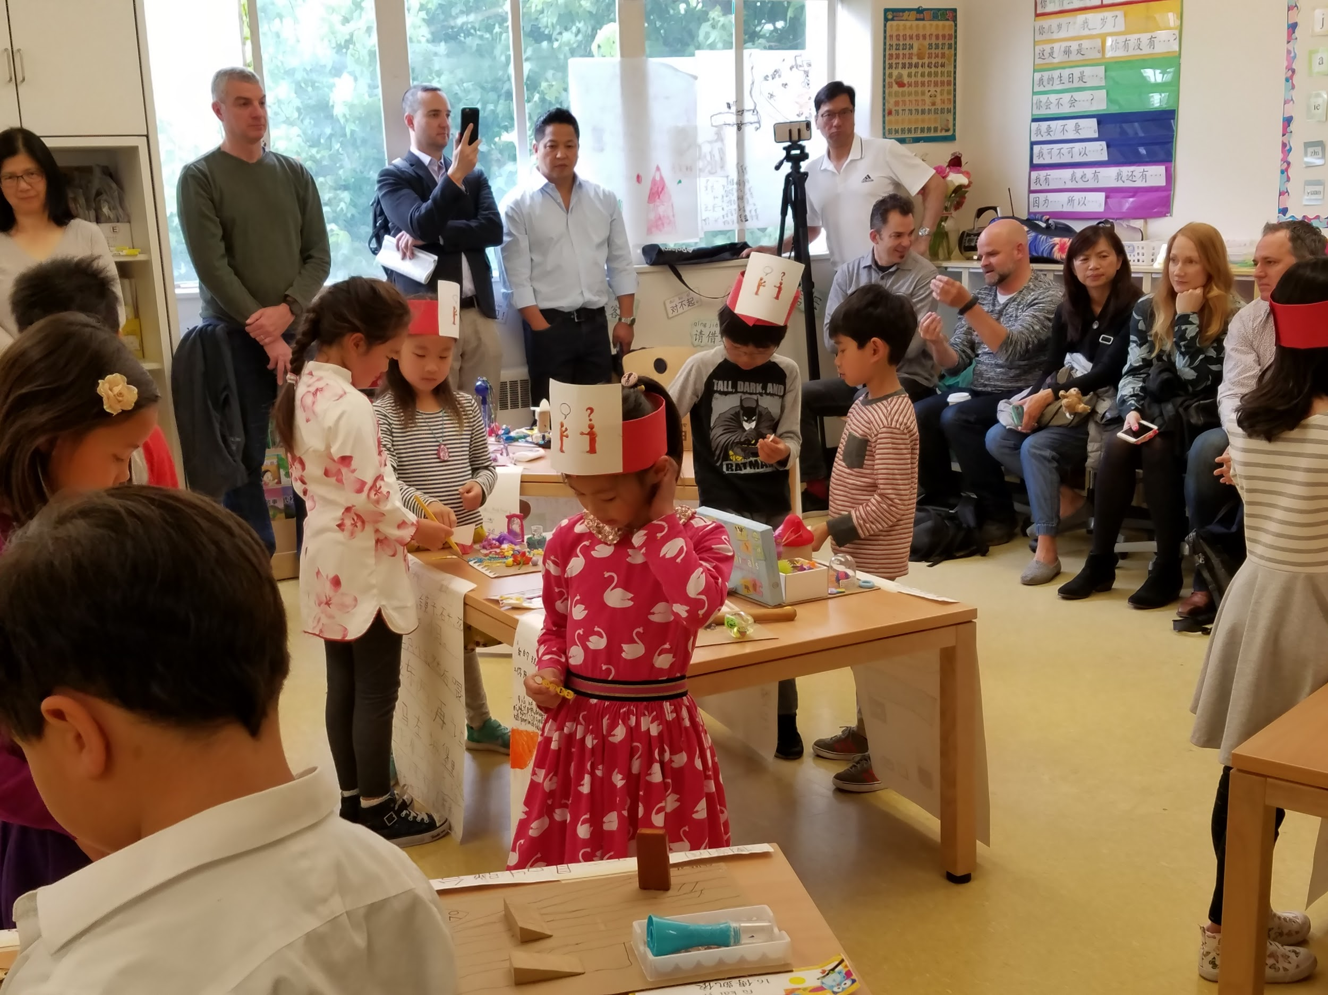
Engaging the Students

Slide 26
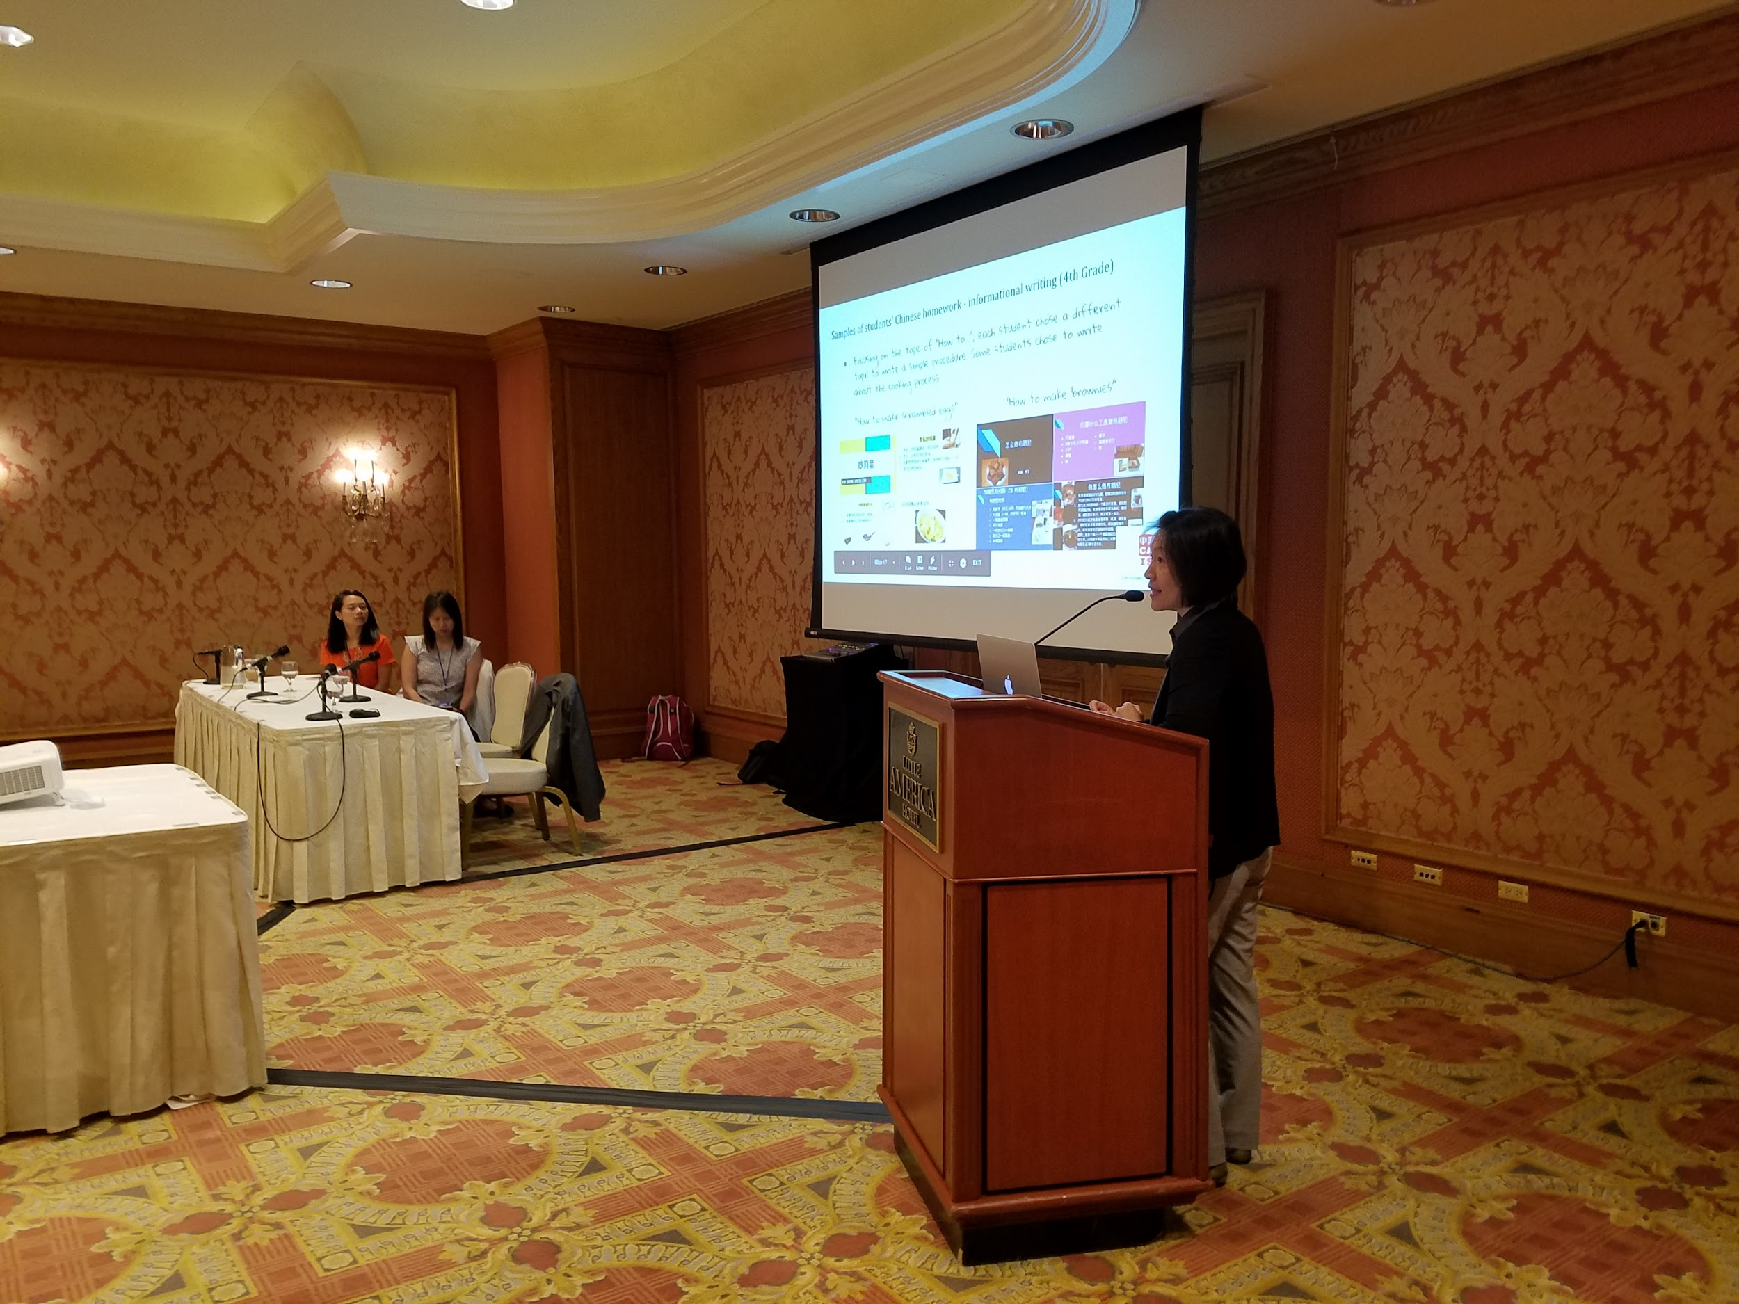
3. Leadership Advocacy
What do we need in the field of Chinese Education?
How do we get there?

Slide 27
What do We Need?
Professional Knowledge
Desire for Continuous Improvement
Being Collaborative
Love and Care for students and colleagues we work with

Slide 28
Chinese Specific Professional Development
EXTERNAL PD
OPI Training (Chinese language trainer)
WPT Training (Chinese language trainer)
Curriculum Design ( Chinese language consultant)
NCLC, ACTFL, STARTALK, Chinese Innovation Forum
This work is licensed under the Creative Commons Attribution-NonCommercial-ShareAlike 4.0 International License. To view a copy of this license, visit http://creativecommons.org/licenses/by-nc-sa/4.0/
Notes:
KEVIN
13 certified OPI testers, 7 more in certification process
9 certified WPT raters, 1 in certification process

Slide 29
We need to create
leadership opportunities
for future leaders

Slide 30
What We Have Done So Far...
PLC leaders:
International Program Assistant Coordinators
Taiwan G5, Guilin G7, Yunnan G8
Summer camp:
Lead teacher training
Mentor camp teachers
Task managers: Behavior and Spirit

Slide 31
Building a Community Not Just a Network What Chinese Innovation Forum Can Do
Online
Lotus Perry University of Puget Sound Tacoma, Washington ACTFL Convention & Expo, November 16, 2019

Slide 32
Complete the Survey & Share your Comments What can CIF do for YOU?

Slide 35
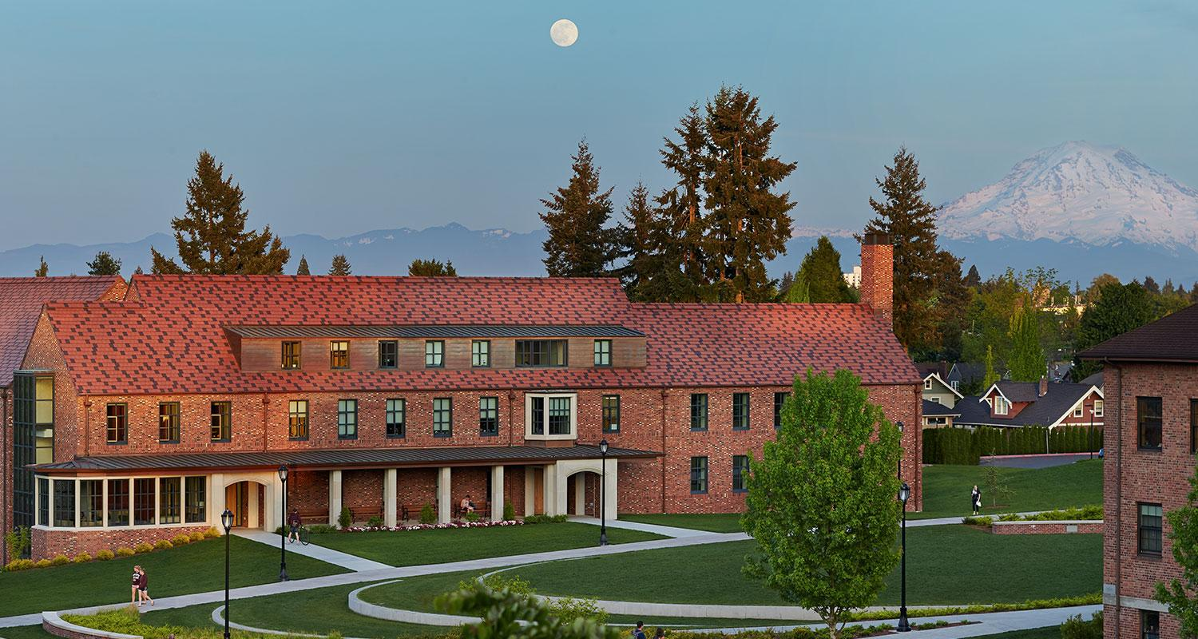
The 5th Chinese Innovation Forum (October 25-26, 2019) at University of Puget Sound, Tacoma, WA

